Slide 1
Spirituality of Our patron Saints.

Slide 2
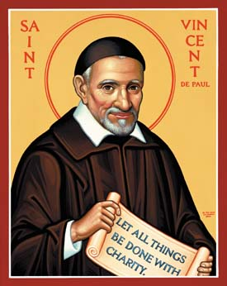
St. Vincent De Paul

Slide 3
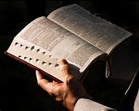

Slide 4
What is spirituality ?
Spirituality refers to situating God at the center of one's heart . Spiritual person is led by the spirit .
Spirituality gives prominence to the life of the person , refers to the disposition of a person .
Spirituality is openness to God.

Slide 5
Every Spirituality has seven elements in common .
1. A capacity to live morally .
2. Non violence .
3. Solidarity with all life and the Earth itself.
4. A Spiritual practice and self knowledge .
5. Simplicity of life.
6. Selfless service
7. Prophetic Action.

Slide 6
Spirituality
Christ lies at the heart of St. Vincent’s spirituality
Rooted in Christ’s love
Love in Action

Slide 7
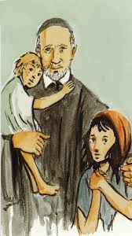
Who is St Vincent
.
Vincent was born in 1581.
ST Vincent de Paul was a priest of the Catholic Church who dedicated himself to serving the poor.
He is venerated as a saint in the Catholic Church and the Anglican Communion.
He was canonized in 1737.^{[1]}

Slide 8
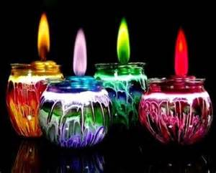
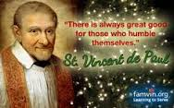
In 1885, Pope Leo XIII named him patron of the Sisters of Charity.^{[5]} He is also patron to the Brothers of Charity.
St. Vincent de Paul is the patron of all works of charity.

Slide 9
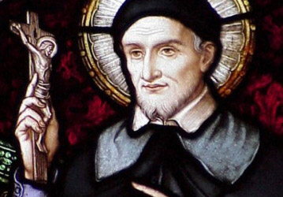
Champion of the Poor
Patronage of charity
Renowned for his compassion, humility, and generosity
Great Apostle of Charity.
Patron of the Sisters of Charity and Brothers of Charity.

Slide 10
Encountering Christ in the Poor
St. Vincent teaches us to see Christ in the poor and suffering, so much so that the poor become our Lords and Masters and we their servants. Vincentian spirituality is centered around this concept. Jesus said “Whatever you did for one of these least brothers of mine, you did for me.

Slide 11
St. Vincent teaches us to see Christ in the poor and suffering, so much so that the poor become our Lords and Masters and we their servants.
Vincentian spirituality is centered around this concept. Jesus said “Whatever you did for one of these least brothers of mine, you did for me.

Slide 12
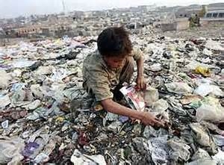
To Be Evangelized By the Poor.
“The poor have much to teach you. You have much to learn from them.”
we are inspired and humbled by their faith and hope in God under the worst of circumstances.

Slide 13
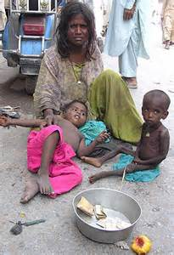
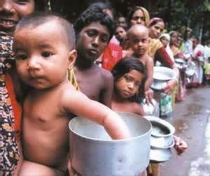
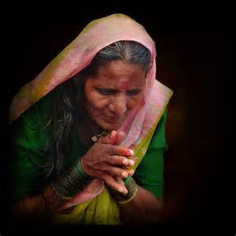
To Evangelize the Poor
The Poor Are Our Masters

Slide 14
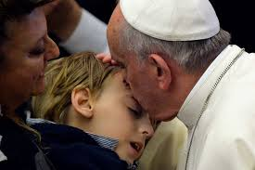
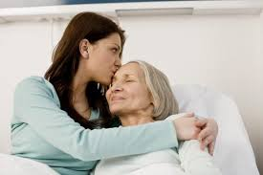
“Let us work with a new love in service of the poor, looking for the most destitute and abandoned among them.
“In serving the sick, you should have God alone in view.

Slide 15
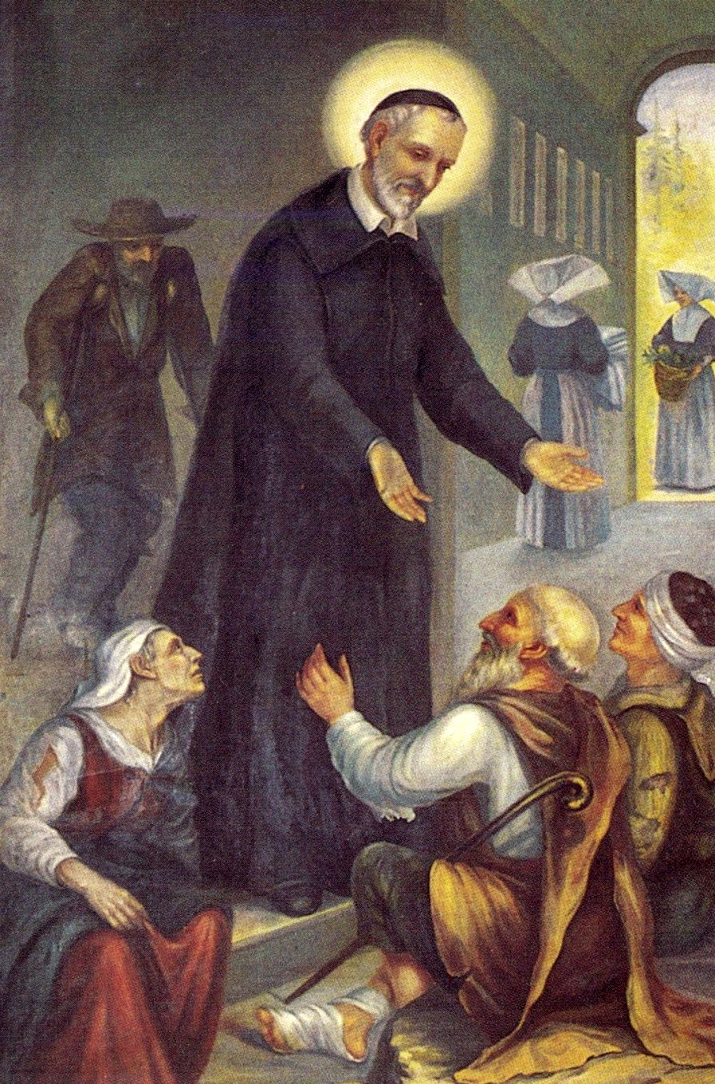
Live the Gospel
We are called to live the Gospel.
We have to witness God’s love by embracing all works of charity and justice.
To provide loving and compassionate interest in individuals
We see the face of Christ in all we serve.
Encouraged actions much more than intellectual and scholarship

Slide 16
Evangelizer of the Poor
“There is no better way to assure our eternal happiness than to live and die in the service of the poor within the arms of providence and in a real renunciation of ourselves by following Jesus Christ”.
“To make God known to the poor, to announce Jesus Christ to them, to tell them that the kingdom of heaven is at hand and that it is for the poor. 0 how great that is and so sublime is it to preach the gospel to the poor that it is above all the office of the Son of God”.

Slide 17
Live these virtues
Simplicity
Mortification
Zeal
Humility
Meekness

Slide 18
Community Living
“Be united with one another, and God will bless you. How can you attract people to Christ if you are not united with one another and with him”?
Community as God's gift and true community do not stifle diversity True community is not simply physical or functional presence. It is being with and for the other person.
Must live with love, peace, joy and happiness live these virtues

Slide 19
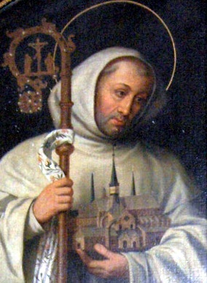
SAINT BERNAD OF CLAIRVAUX
BORN: 1090
DIED :20 AUG-1153
RELIGEION: ROMAN CATHOLIC
NATIONALITY: FRANCE

Slide 20
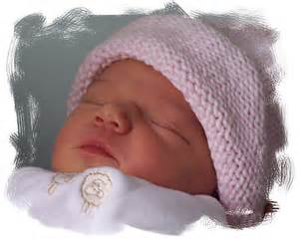
Bernard was born to a noble family, the third of seven children. Five of his six siblings were brothers, all of which trained as soldiers and entered the army. Bernard , however from his youth was destined for the scholarship and piety. Bernard attained great success as a secular scholar, but more and more felt called to the monastic life. At the age of 22 he joined the order and was so passionate and educated about his faith that he convinced 30 of his friends and relatives to join him.

Slide 21
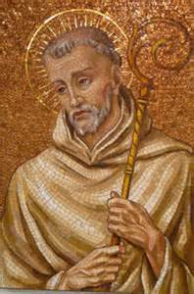
He displays a nobility of nature, a wise charity and tenderness in his dealings with others, and a genuine humility.
St Bernad was eminently endowed with the gift of miracles.

Slide 22
SAINT BERNAD
Throughout his life,Bernrad continued to write about our Blessed Mother , the one who distributes God’s benefits to the restoration of the universe .
The legacy of Saint Bernard of Clairvaux to 20th-century Christians, as multifaceted as it is, lies most significantly in his profound human psychology of self-esteem and self-awareness grounded in the mercy and love of God.

Slide 23
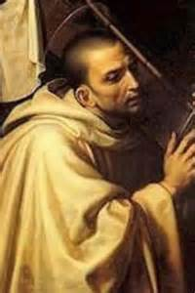
The central elements of Bernard’s Mariology were; how he explained the Virginity of Mother Mary, the “STAR OF THE SEA” through his many writings, devotion to Our Blessed Mother spread throughout the world.
Bernard belongs to this tradition. He was nourished and shaped by the language of the Bible.

Slide 24
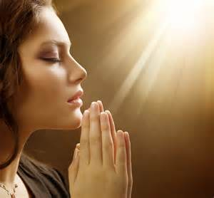
Stages of Contemplation-Bernard of Clairvaux The Stages of Contemplation are two,

Slide 25
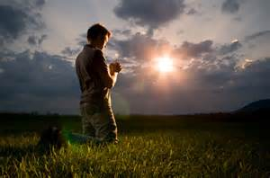
The first stage of contemplation, is to consider constantly what God wants,
what is pleasing to him, and what is acceptable in his eyes.

Slide 26
These two stages
These two stages sum up the whole of the spiritual life: when we contemplate ourselves we are troubled, and our sadness saves us and brings us to contemplate God; that contemplation in turn gives us the consolation of the joy of the Holy Spirit. Contemplating ourselves brings fear and humility; contemplating God brings us hope and love.

Slide 27
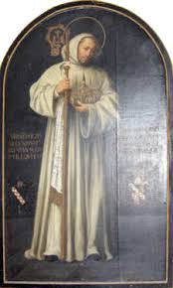
Bernard outlines threefold process of spiritual growth,
The first perfume, or ointment, is that of repentance, or sorrow for sins.
The second is that of devotion, of confident praise and worship of God.
The third is that of compassion and mercy.

Slide 28
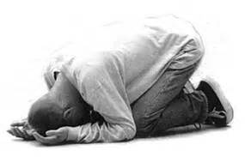
The first one, signifying contrition and brokenness over our sins, is pungent and painful.

Slide 29
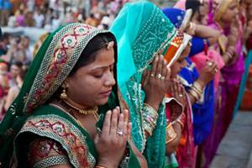
The second adds the healing and soothing process of growth. And , is essentially that of worship and praise of God.

Slide 30
The third perfumed anointing is the overflowing of mercy and compassion that comes from maturity in the spiritual life.

Slide 31
Conclusion
Spirituality is in actions invite us,
Christ should be our center and priority, we may see Christ face in others by serving and helping the needy, wounded and helpless.

Slide 33
HAVE A joyful DAY!
Kasur Community

